Slide 1
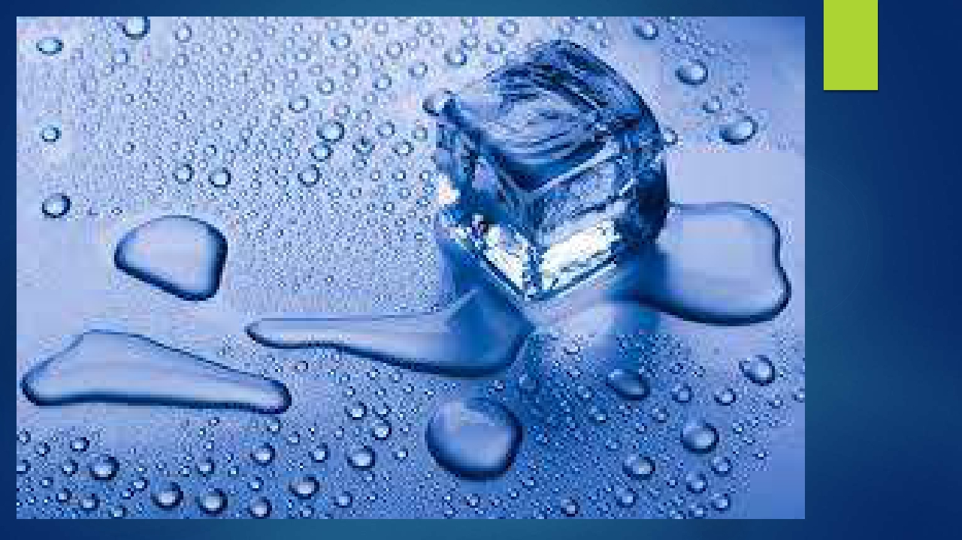


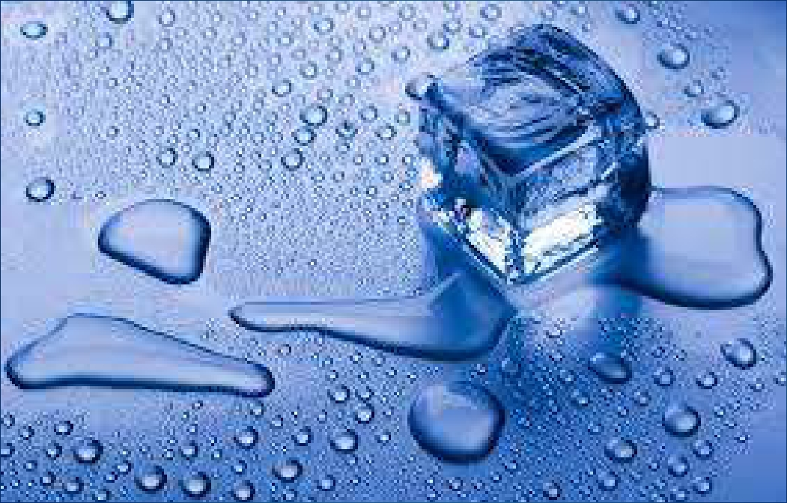
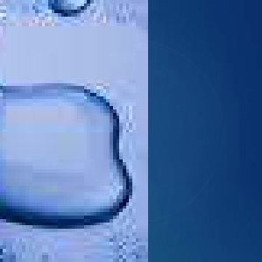
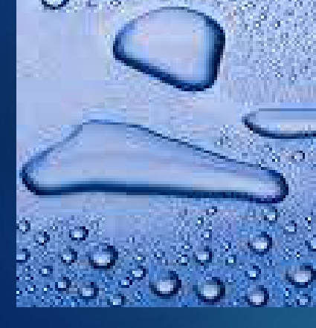

By:
SUMAN KUMARI
ASSISTANT PROFESSOR
DEPARTMENT OF B. VOCATIONAL SPORTS
NUTRITION AND PHYSIOTHERAPY
KANYA MAHAVIDYALAYA KARKHODA
C
R
Y
O
T
H
E
R
A
P
Y

Slide 2



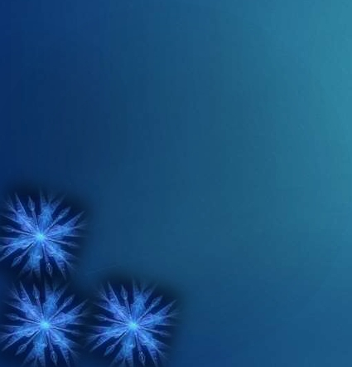
DEFINITION
The word Cryotherapy is formed of two words: CRYO and
THERAPY.
'CRYO' means cold.
'THERAPY' means cure.
Hence,
◆
◆
◆
◆
The application of cold for various therapeutic purposes is
termed as CRYOTHERAPY.

Slide 3
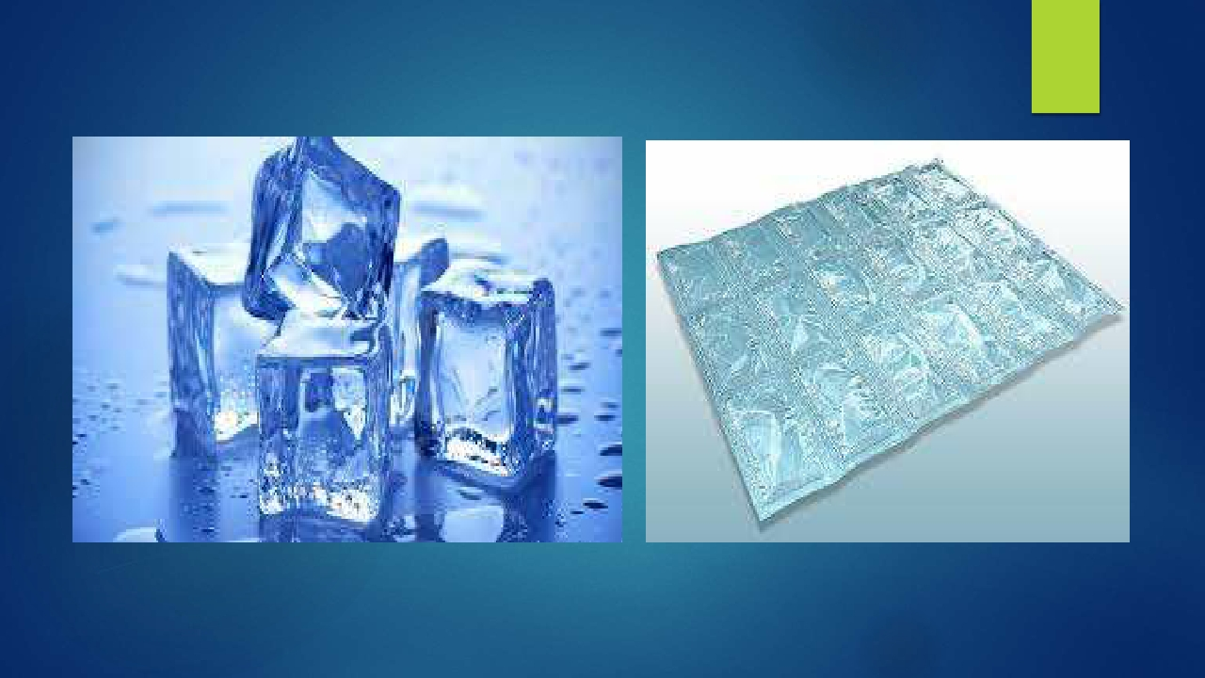
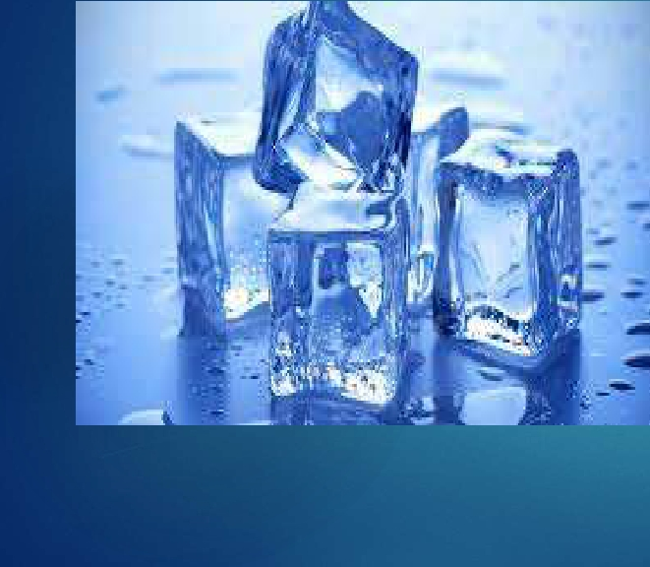
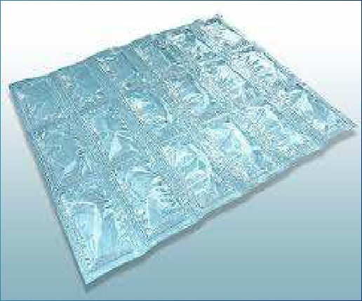

Cryotherapy uses various kinds of low temperature agents such as....
ICE CUBES
FROZEN GEL

Slide 4
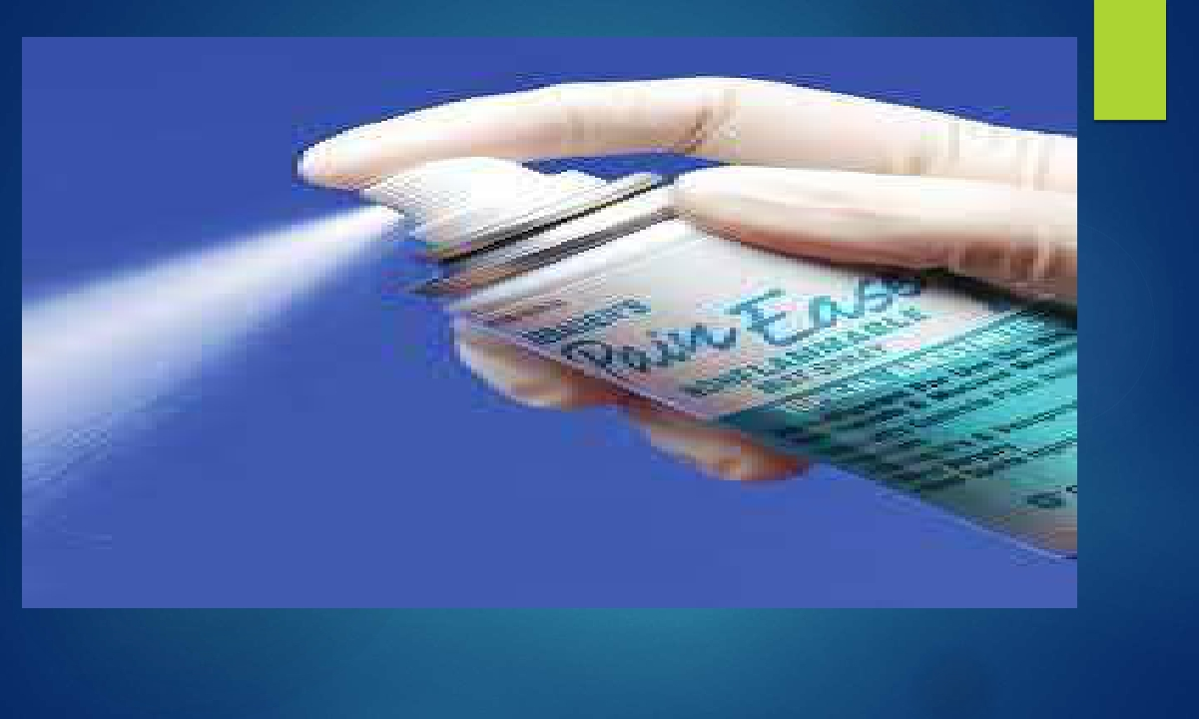
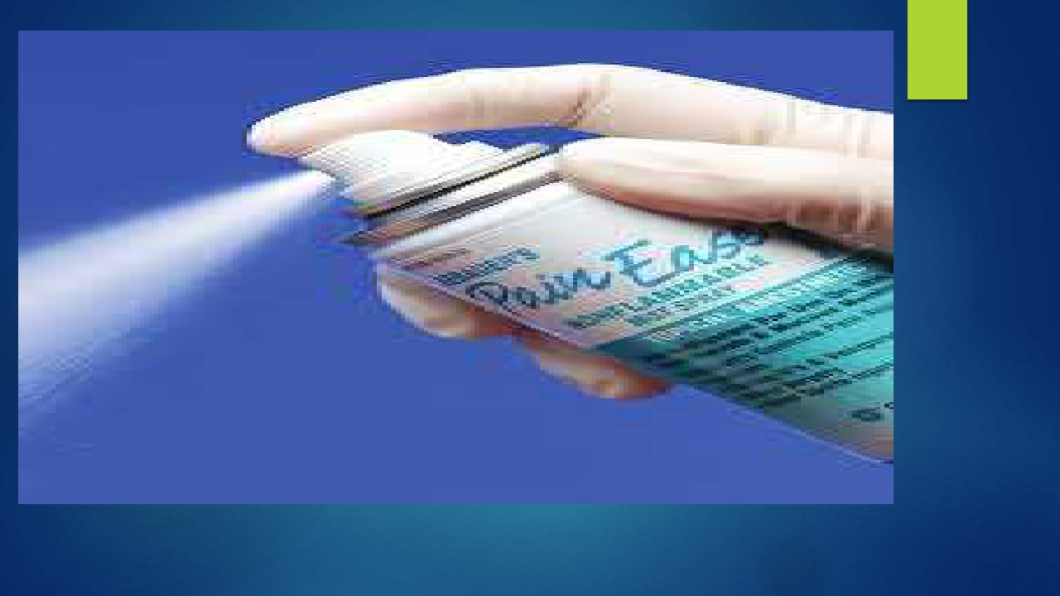
VAPOCOOLANT SPRAYS

Slide 5
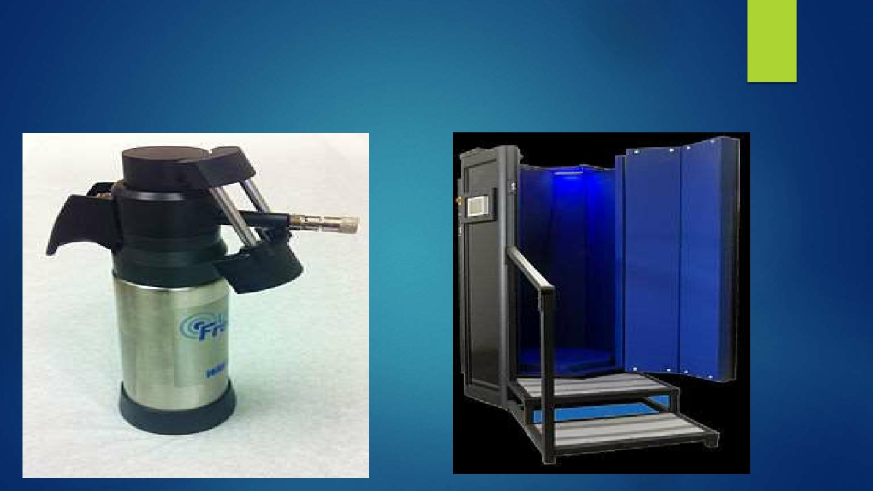
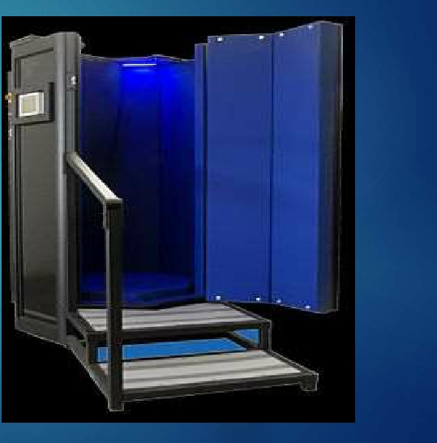
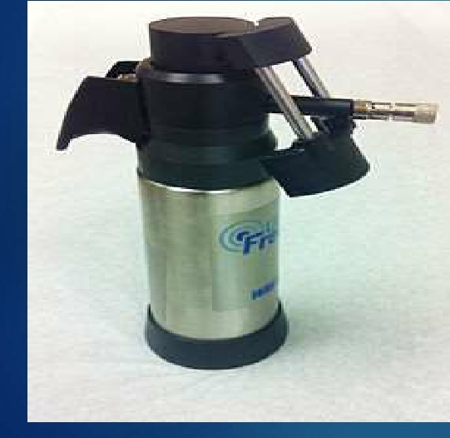
Various other medically used cryotherapy equipments are being used.
Medical Cryotherapy Gun
Octagonal Cryosauna

Slide 6
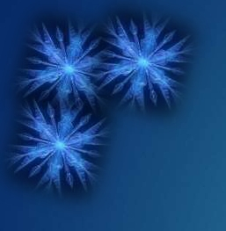
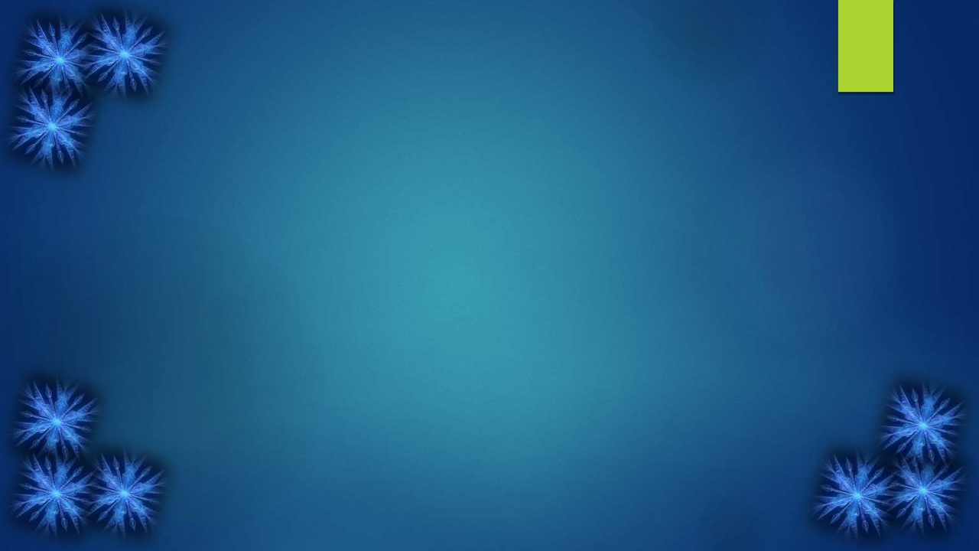
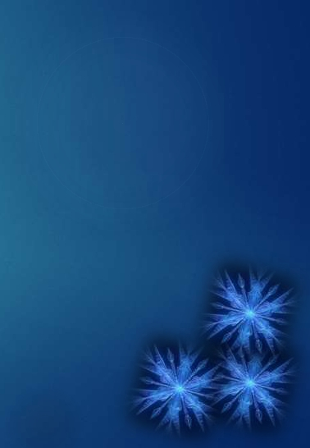
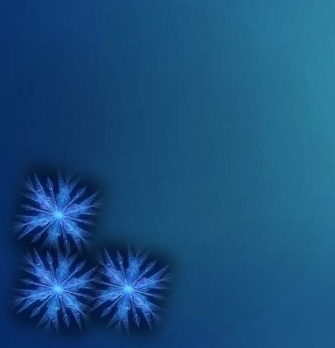
PRINCIPLES
Latent heat: A specific amount of energy is required to change
the solid form of a particular substance into a liquid, or the liquid
into a gas.
By the use of cryotherapy heat from the tissues of the body is
absorbed by the cooling agents.
Heat loss from the tissues is more when ice is used in place of
water.
◆
◆
◆

Slide 7
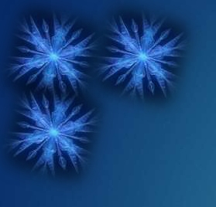
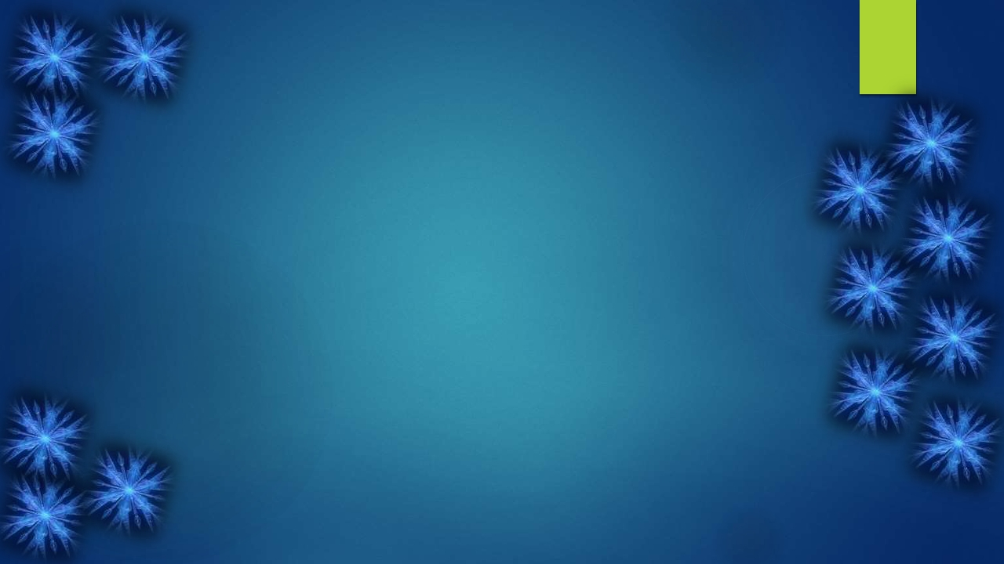
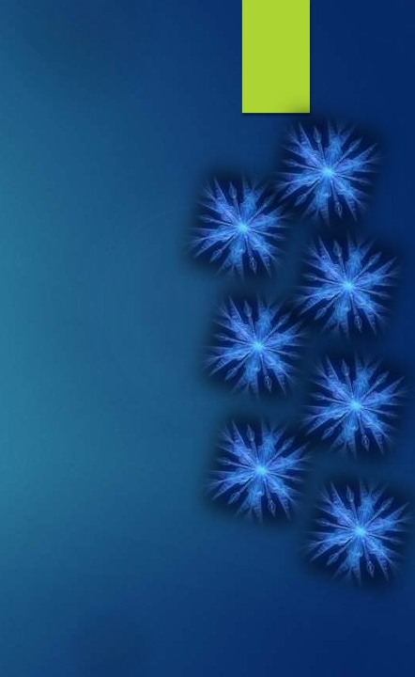
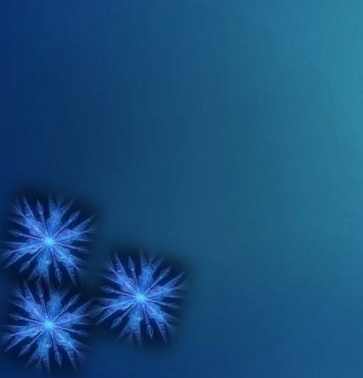
COOLING
The magnitude of cooling depends upon:
◆
1.
2.
3.
The Area: According to the size and conductivity of the
tissue exposed.
The Temperature: Difference between the temperature of
the cooling agent and the tissue its being applied to.
The Duration: Time period of the cold application.

Slide 8
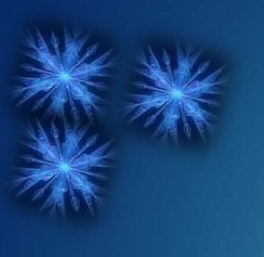
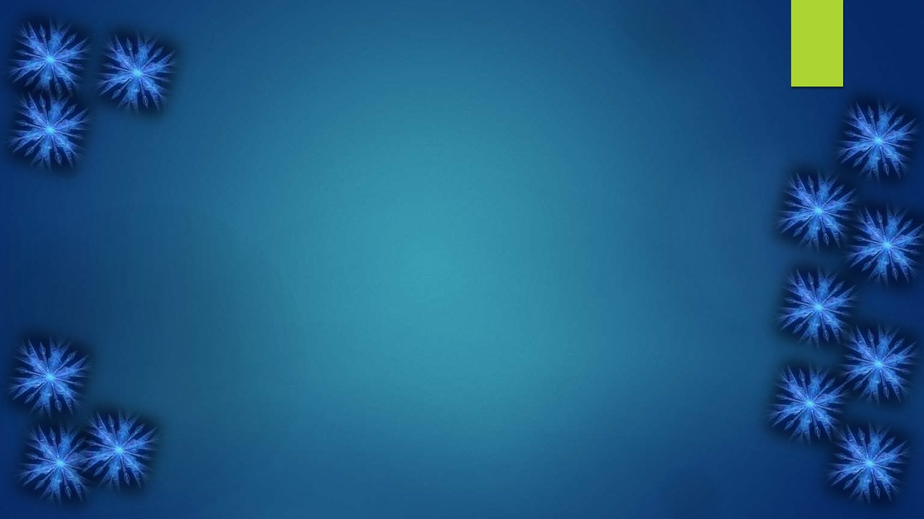
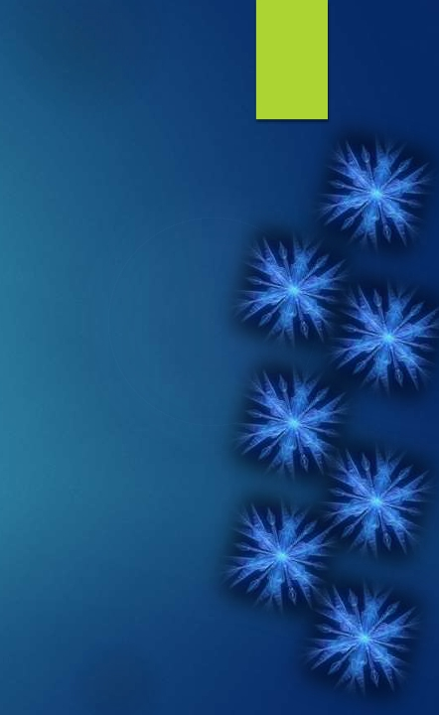
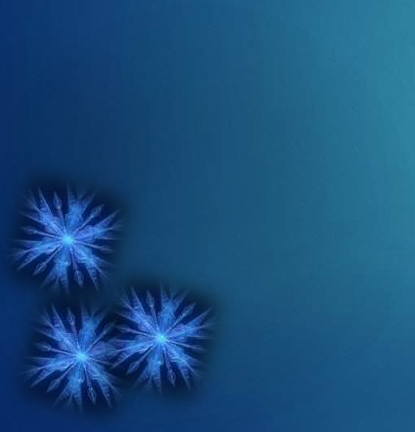
PHYSIOLOGICAL EFFECTS
◆
Homodynamic or Circulatory Effect
◆
Neuromuscular Effect
◆
Metabolic Effect

Slide 9
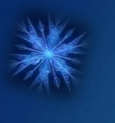


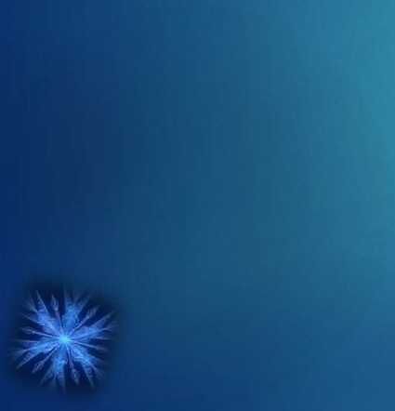
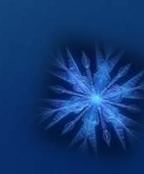
1. HOMODYNAMIC EFFECT
Initial response of the body tissue to cold is to preserve heat.
This preservation of heat occurs through the initial phase of
vasoconstriction that occurs due to contraction of the smooth
muscles of the blood vessels.
This vasoconstriction persists for about 15 to 20 minutes in order
to retain body homeostasis.
If the application of cold is still continued furthermore then there
occurs a cold induced vasodilatation to warm the part that is
being cooled down.
◆
◆
◆
◆

Slide 10
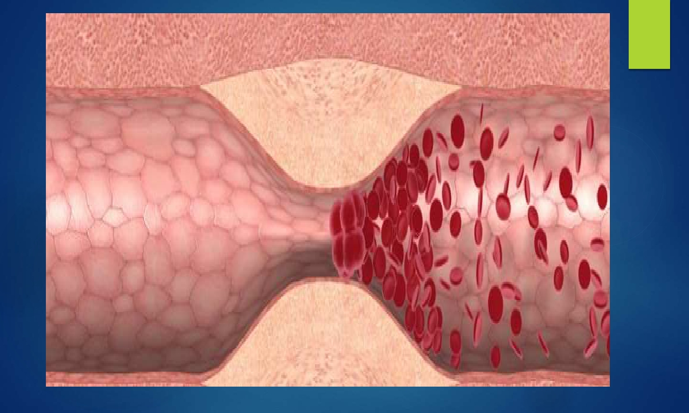
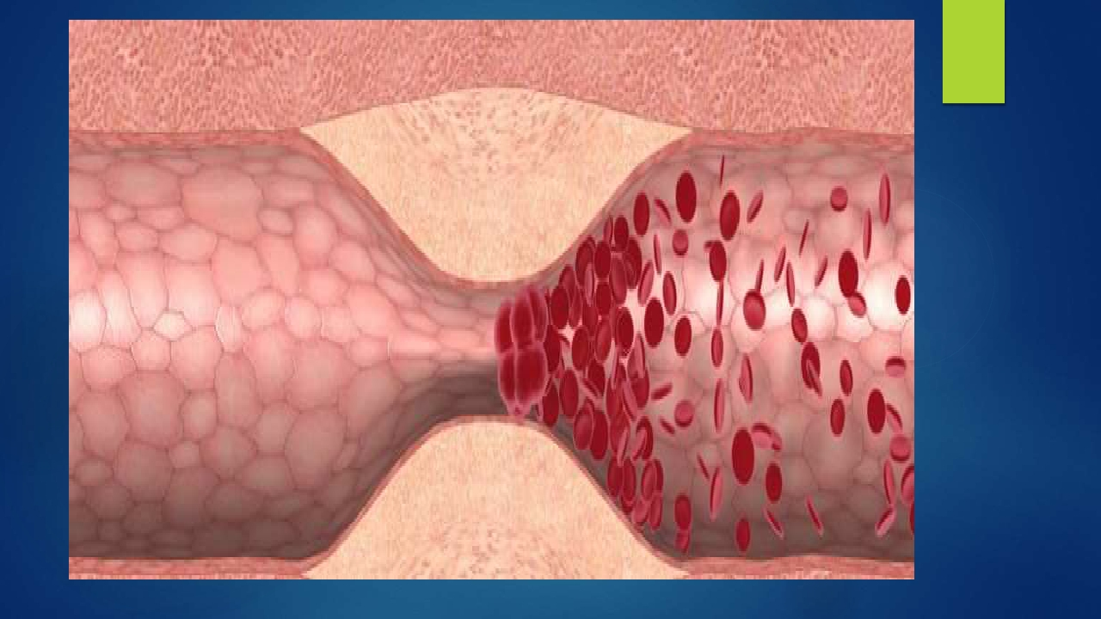

Slide 11
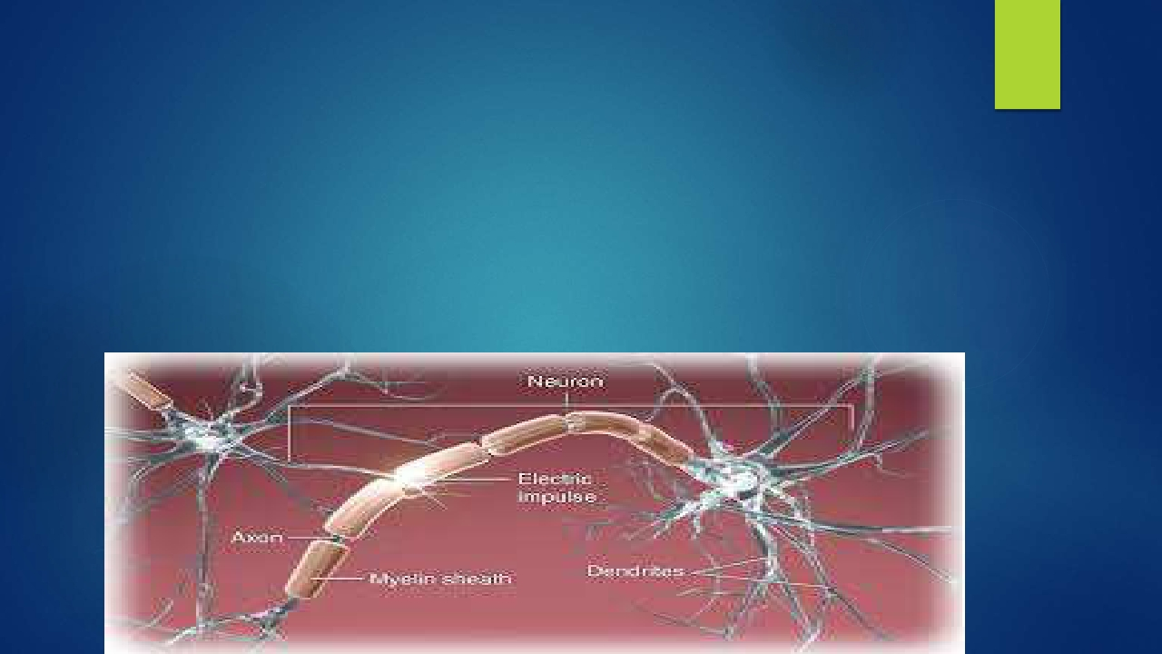
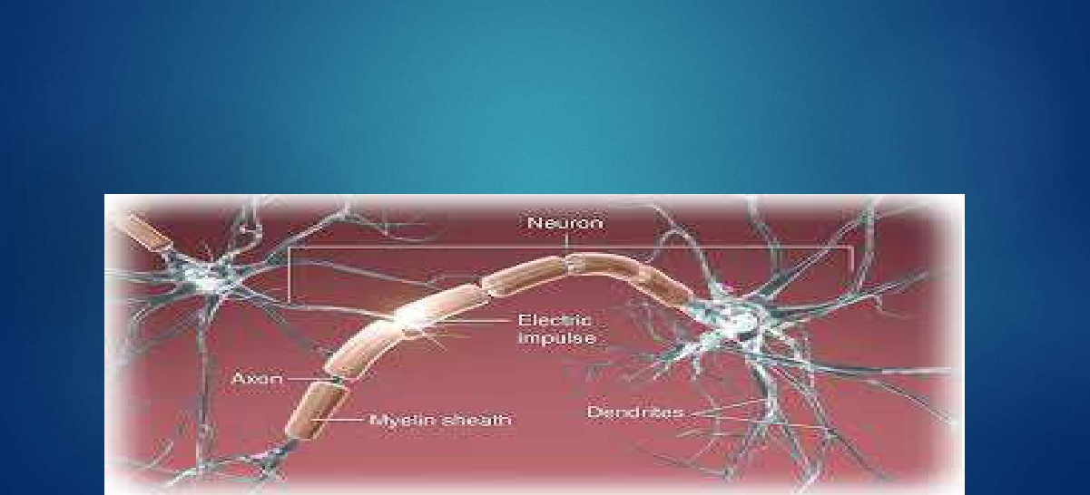
2. NEUROMUSCULAR EFFECT
1. Decrease in nerve conduction velocity:
Total nerve conduction block occurs when cryotherapy
is applied over nerve trunk.
20 minutes of cooling takes about 30 minutes for
normal nerve conduction velocity.

Slide 12





2. Increase in pain threshold:
Decrease in pain is due to increase in pain threshold that occurs
through the pain gate mechanism.
By reduction in the pain the application of cryotherapy also helps in
breaking the pain – spasm cycle.
3. Decrease in spasticity:
There occurs temporary reduction in the spasm.
It occurs as a result of decrease in the activity of gamma motor
neurons, muscle spindle and golgi tendon organ.

Slide 13

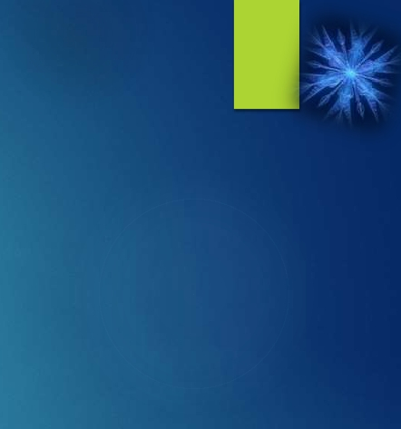
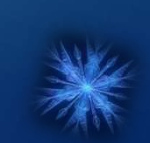
3. Facilitation of muscle contraction:
Cold enhances excitability of alpha motor neurons.
In flaccid paralysis phase of hemiplegia, muscle contraction can be
facilitated if the lower motor neuron is intact.
5. Alteration of muscle strength:
Cold applied for 5 minutes or less increases muscle strength due
to increase excitability of motor neuron.
If cold is applied for 30 minutes or more, then there occurs initial
decrease in strength followed by a gradual increase in muscle
strength.

Slide 14

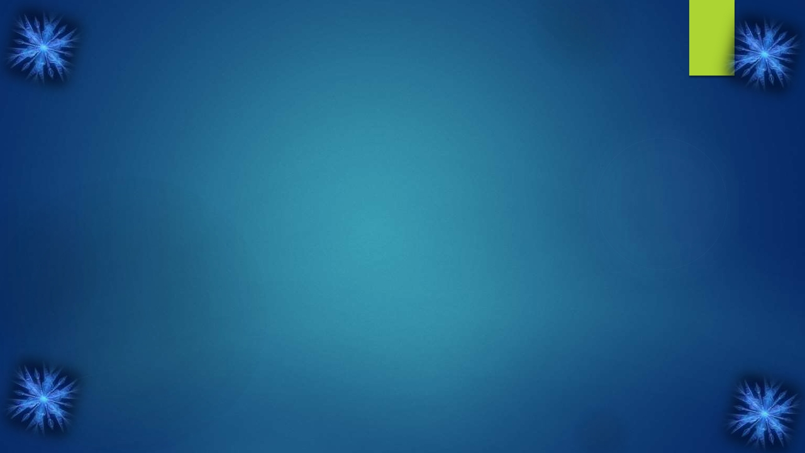

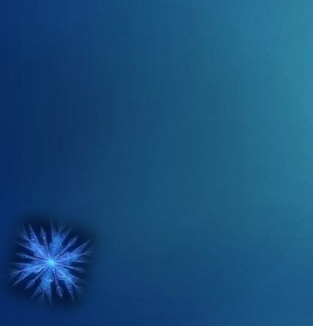
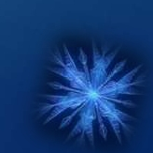
3. METABOLIC EFFECTS
Cold reduces metabolic rate.
For this reason cold is used in acute inflammations where there
is an abnormal demand for metabolic reactions.
Cold reduces bleeding, swelling and local muscle spasm.
It inhibits activity of cartilage destroying enzymes like
collagenase, elastase, protease etc thereby help in healing of
ligament injuries, osteoarthritis, rheumatoid arthritis.
◆
◆
◆
◆

Slide 15
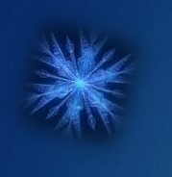
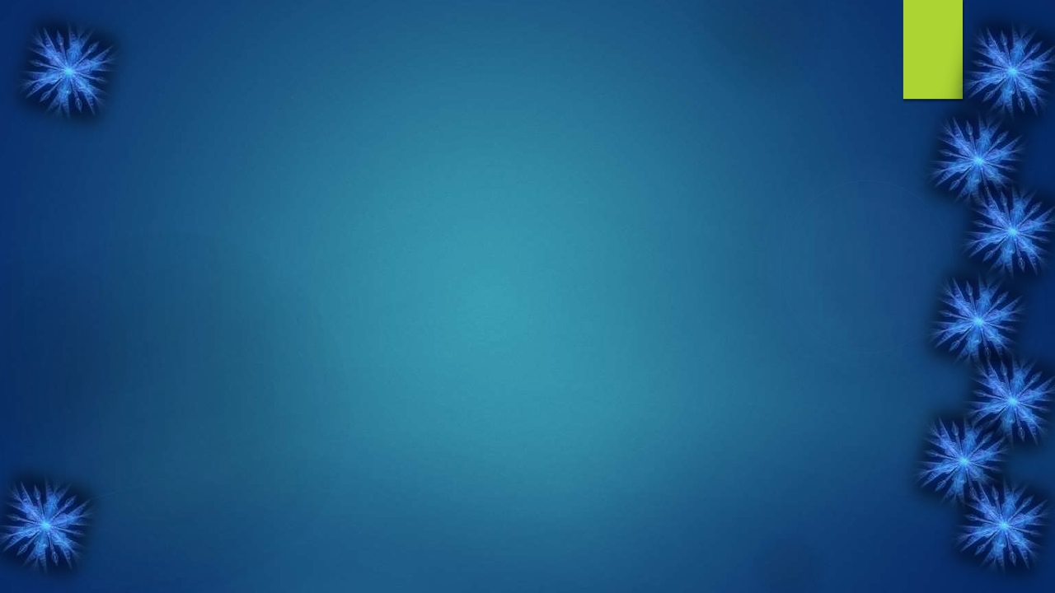
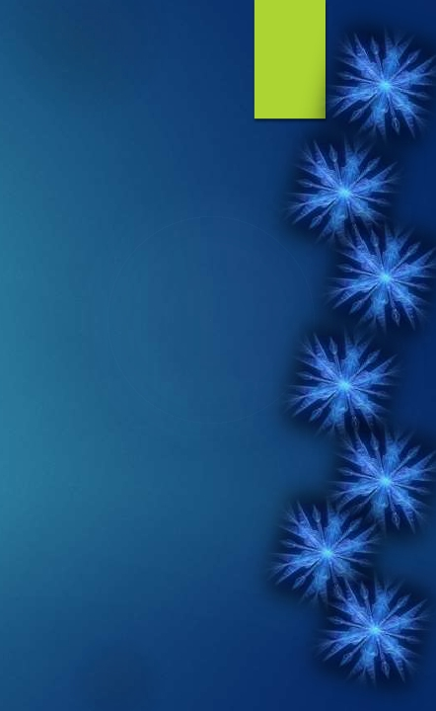
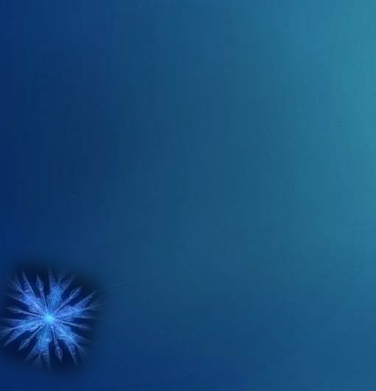
THERAPEUTIC EFFECTS
Therapeutically cryotherapy helps in :
◆
1.
2.
3.
4.
5.
6.
Acute inflammations
Control of pain
Reduction of spasticity
Facilitates muscle contractions
Controlling edema
Exercising and stretching

Slide 16
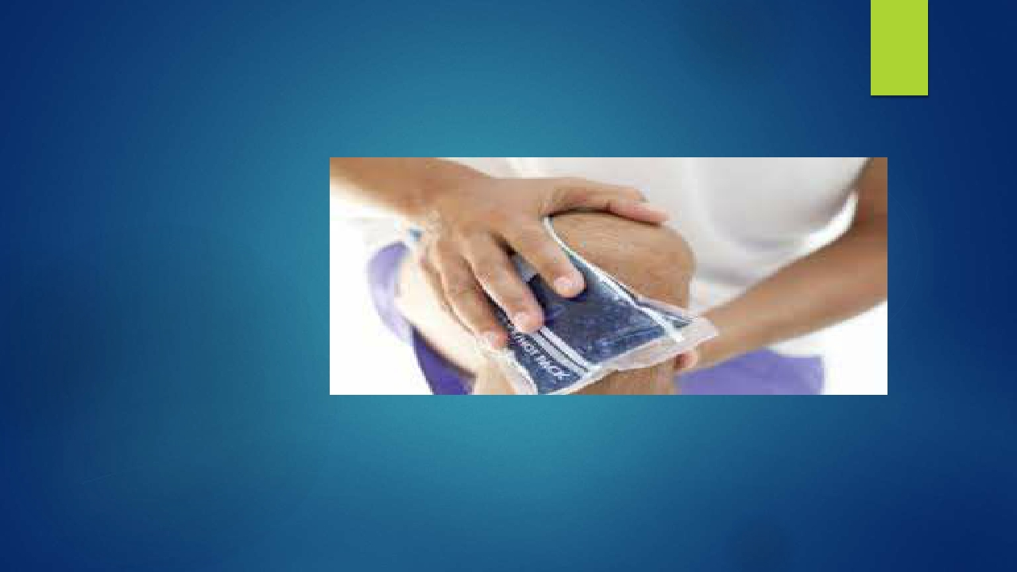
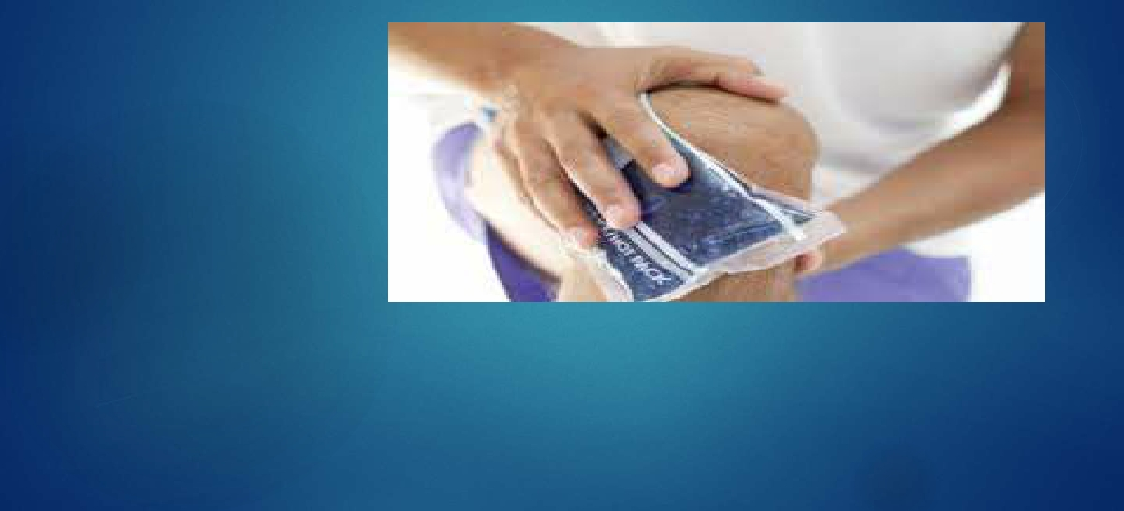
INDICATIONS
1.
2.
3.
4.
5.
6.
Pain relief
Spasticity
Muscle spasm
Swelling
Promote repair
Provide excitatory stimulus when muscle are inhibited

Slide 17
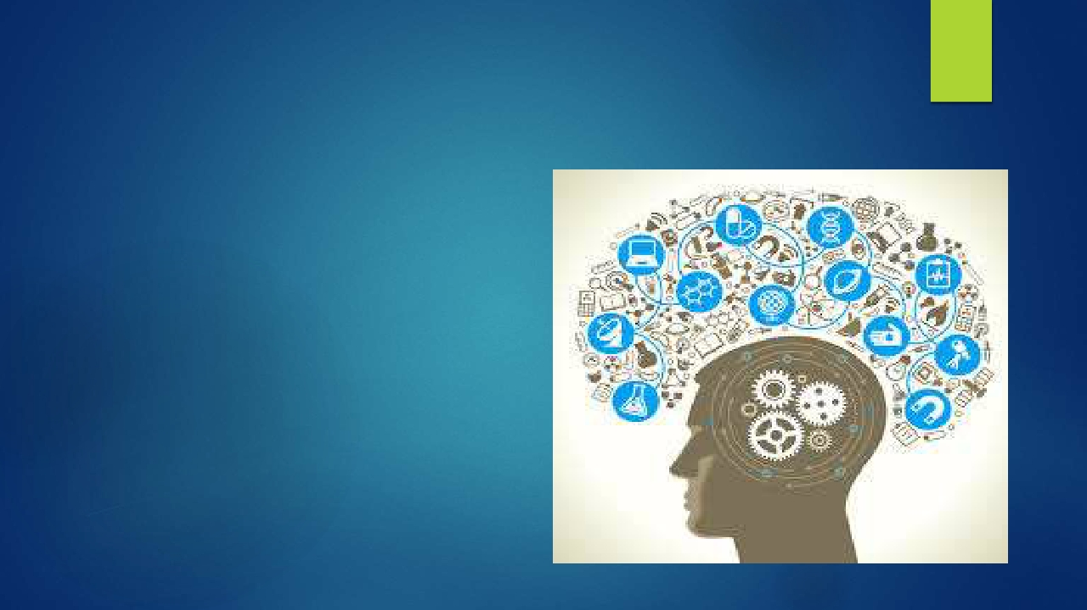
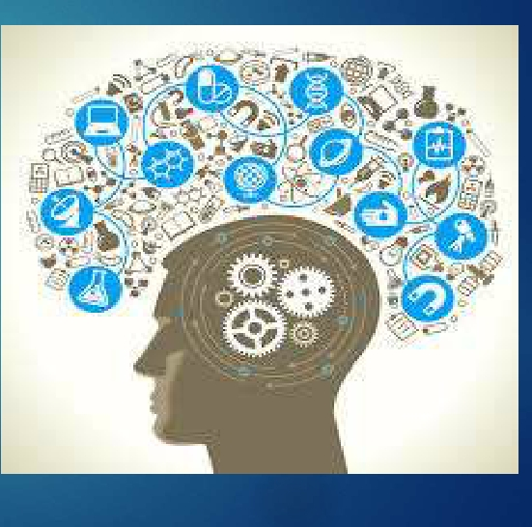
CONTRAINDICATIONS
1. PSYCHOLOGICAL CONDITIONS:
The thought of ice terrifies many patients.
They claim that their condition is made
worse by the application of cold.
If the therapist cannot persuade or
demonstrate to the patients that ice will be
beneficial to them then it might be better not
to use it .

Slide 18
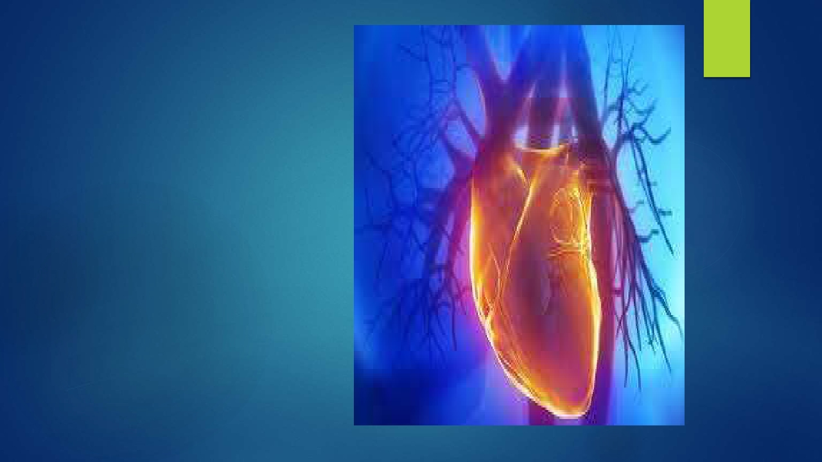
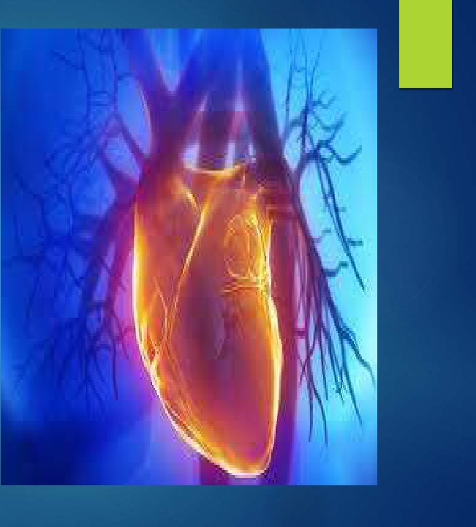
2.CARDIAC CONDITIONS:
For six months after a
myocardial infarct ice
treatment should be
avoided.
Initial shock of ice causes
marked drop in blood
pressure and increase in
heart rate.
Ice applied on left shoulder
cause overflow of excitatory
impulse to heart so cold
application of left shoulder
to be avoided in patients
with cardiac disorder.

Slide 19
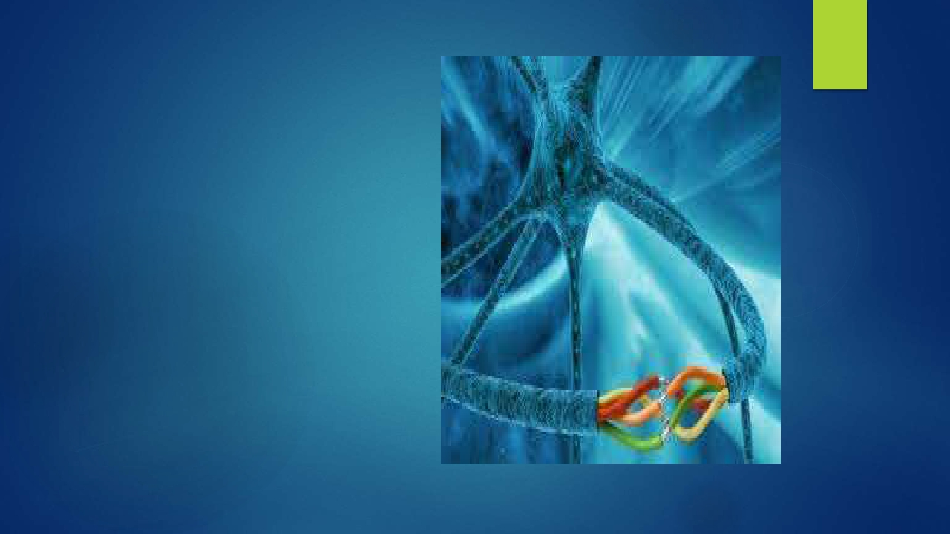
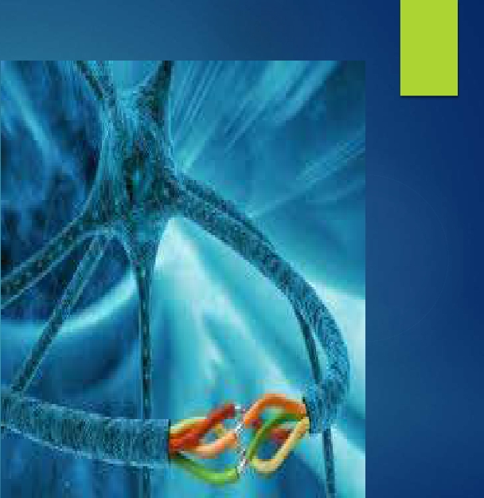
3. PERIPHERAL NERVE
INJURY:
Blood vessels in the area
supplied by a severed peripheral
nerve lose their normal response
to cooling. If such an area were
cooled with ice,the net result
would be that the part would get
very cold and take many hours to
regain a normal temperature.

Slide 20
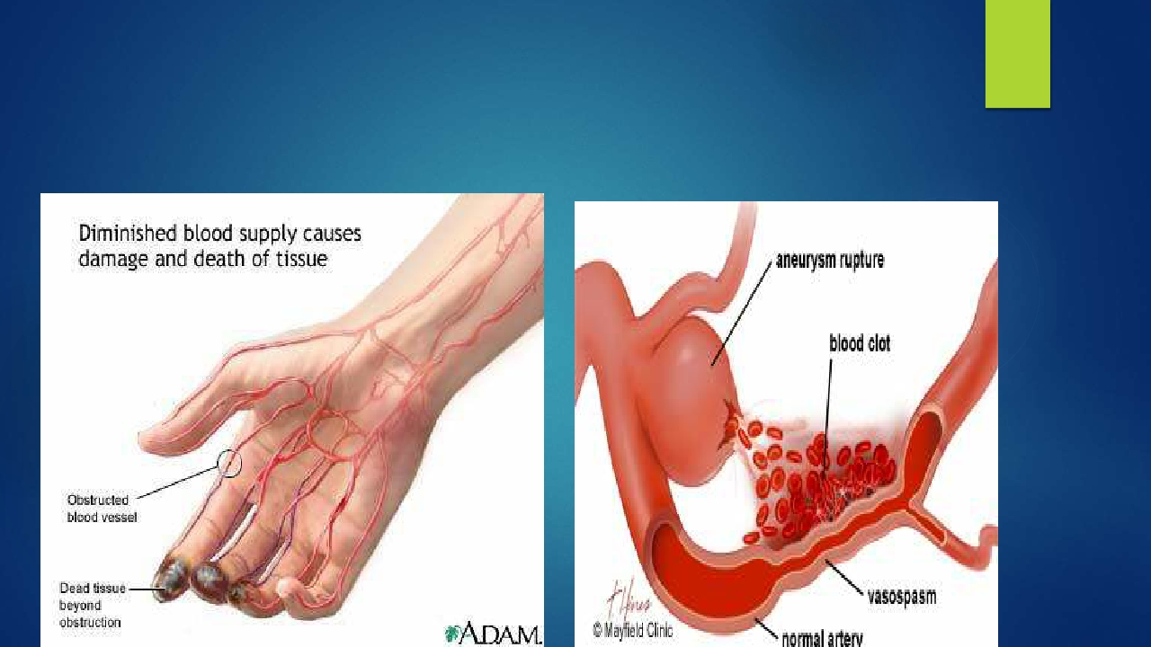


4. VASOSPASTIC DISEASE:
The vasospastic disease such as Raynaud's disease is made
worse by the application of ice.

Slide 21



5. PERIPHERAL VASCULAR DISEASE:
As cold application may reduce an already inadequate blood
supply, ice is avoided.
However, since the metabolic rate of the tissues is also lowered it is
doubtful whether gangrene would ensue from cold treatment.

Slide 22







Slide 23


6. COLD SENSITIVITY:
Even if all precautions are taken
there will still be a small number of
patients who react adversely to
ice.Following the application of
ice, these patients produce a local
histamine like urticaria which looks
like a nettle rash and itches.
These patients are unsuitable for
treatment with ice.

Slide 24




TECHNIQUES OF APPLICATION
ICE TOWELS
ICE PACKS
IMMERSION
ICE CUBE MASSAGE
COLD COMPRESSION UNIT
◆
◆
◆
◆
◆

Slide 25


1. ICE TOWELS:
Popular method of application because there is little danger of
producing an ice burn.

Slide 26




2. ICE PACKS:
Crushed or flaked ice may be placed inside a specially made Terry-
towel bag or an ice towel folded into an appropriate shape.

Slide 27


3. IMMERSION:
Immersion is a technique in which the part to be treated is
immersed in an ice solution. Unfortunately it is only practical to
immerse certain areas such as hands, feet and elbows

Slide 28


4. ICE CUBE MASSAGE:
Ice cube massage is a useful method of application as it does not
require an ice machine. The freezer compartment of a domestic
refrigerator is sufficient. This makes this technique useful in small
departments, in wards and most importantly, in the home.

Slide 29


5. COLD COMPRESSION UNIT:
Cold compression therapy combines of principles of R.I.C.E. (Rest,
Ice, Compression, Elevation) to reduce pain and swelling. This
therapy is especially useful for strains, sprains,pulled muscles and
pulled ligaments.

Slide 30








